Slide 1
Sustainability Tourism Management Database
Group 11
Akshit Verma 002059756
Rushang Dalal 002053714
Sai Tarun Reddy Lakkireddy 002836426
Reva Pethe 002310699

Slide 2
Goals and Features
Goal: Harmonize tourism's economic benefits with environmental and cultural preservation for future generations
Challenges Addressed: Over-tourism, environmental damage, and the need for sustainability in tourism practices
Key Features:
Centralized database consolidating sustainability metrics for informed decision-making
Monitoring environmental impacts (e.g., carbon footprint, water usage, waste)
Measuring and managing destination carrying capacities to prevent over-tourism
Promoting sustainable transportation options
Storing educational content to raise awareness and engagement in sustainable tourism

Slide 3

Stakeholders in Sustainable Tourism
Roles and Decision-Making Impact
Local Governments
Manage over-tourism with visitor caps
Allocate resources for eco-friendly infrastructure
Tourism Businesses
Track and reduce carbon footprints
Promote sustainable services to attract eco-conscious travelers
Environmental Protection Advocates / Activists
Monitor tourism's impact on ecosystems
Advocate policies for conservation and sustainability
Tourists
Choose eco-friendly destinations and activities based on impact data
Engage with educational content to adopt sustainable travel practices
Goal: Empower all stakeholders with actionable insights for responsible tourism

Slide 4
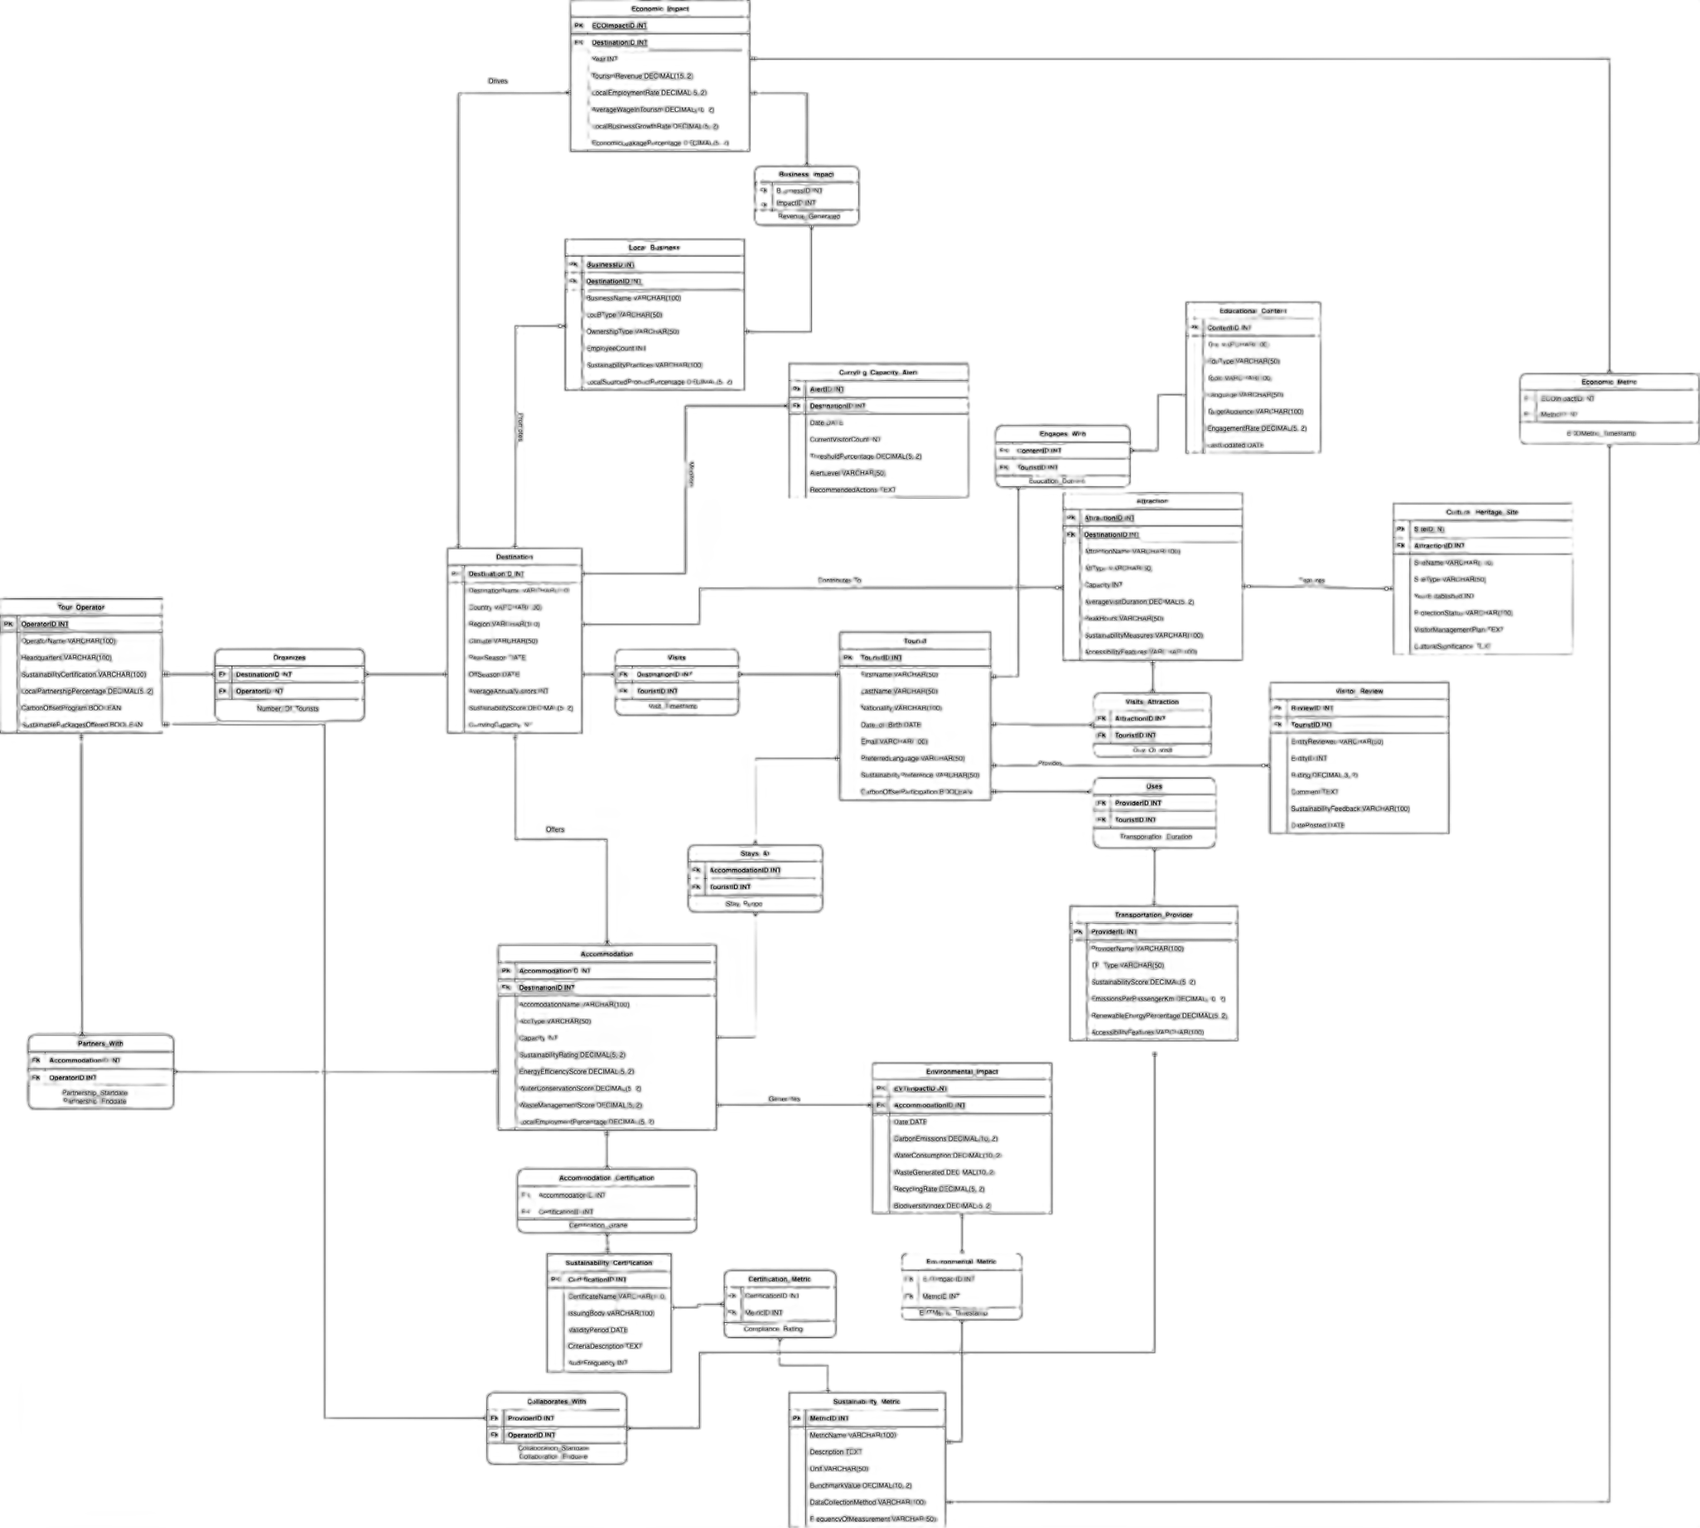
Entity Relationship Diagram

Slide 5
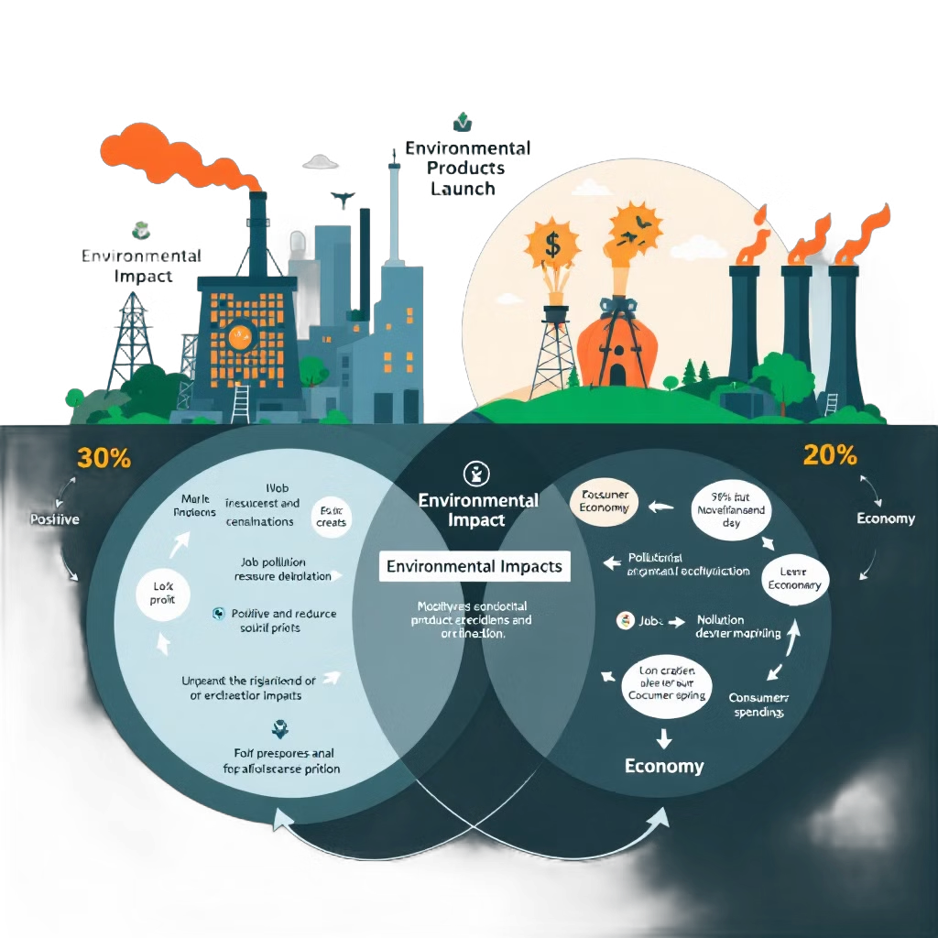
Key Design Decisions
Separate Environmental_Impact & Economic_Impact Entities
Enables stakeholders to analyze environmental and economic factors independently or together
Supports detailed and focused tracking of sustainability dimensions
Flexible Sustainability_Metric Entity
Centralized entity for adding or modifying metrics without altering the database structure
Adapts seamlessly to evolving sustainability standards
Sustainability_Certification as Many-to-Many
Tracks multiple certifications for entities like Accommodations and Tour Operators
Reflects the complexity and interconnectedness of sustainability certifications in tourism

Slide 6
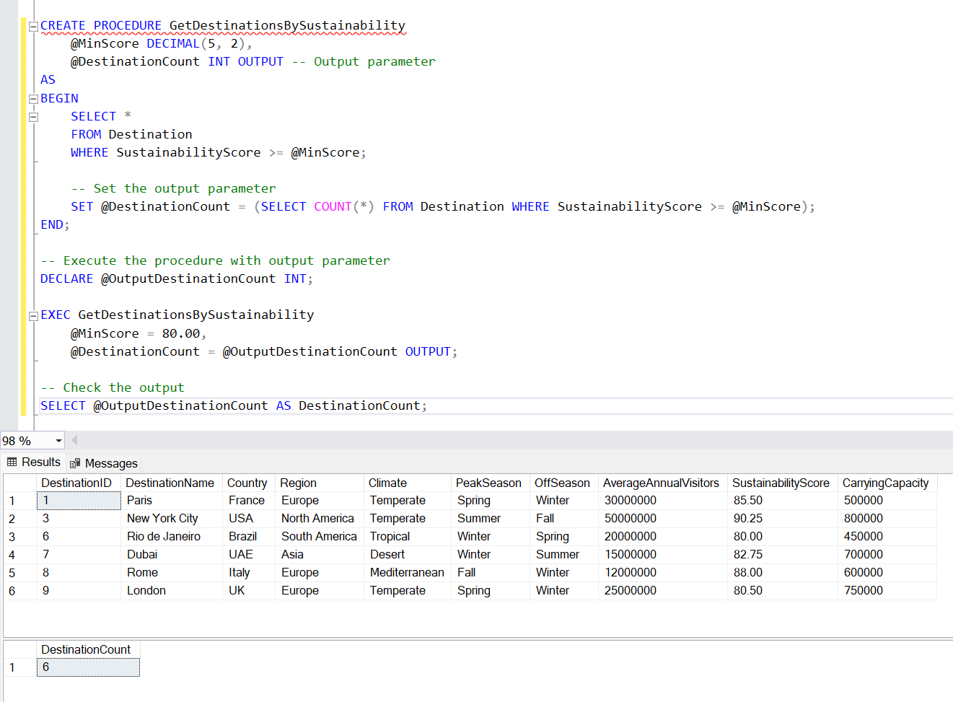
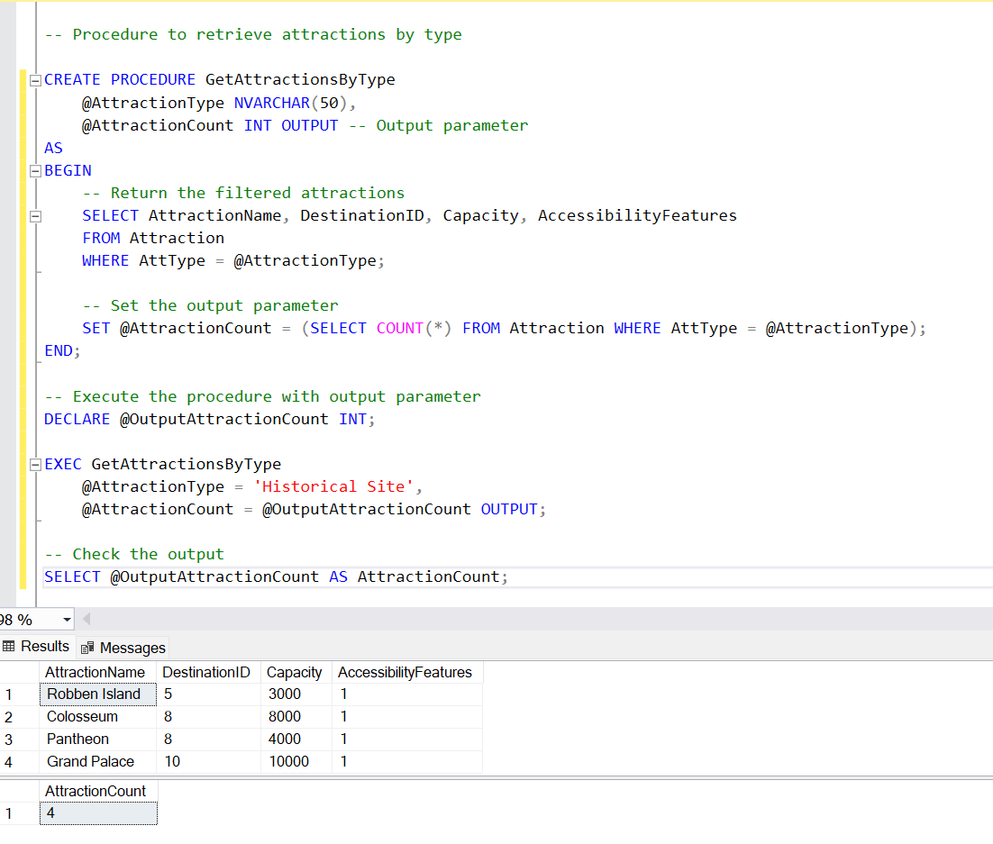
Stored Procedure
GetDestinationsBySustainability
GetAttractionsByType

Slide 7
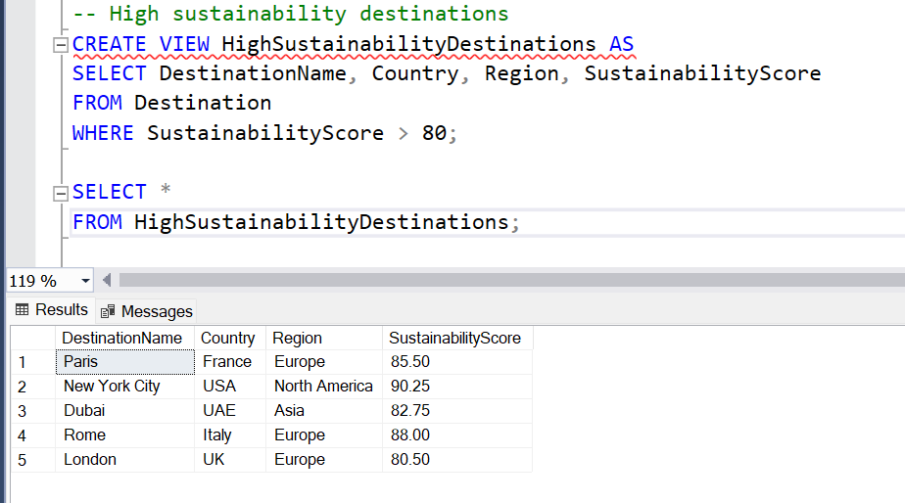
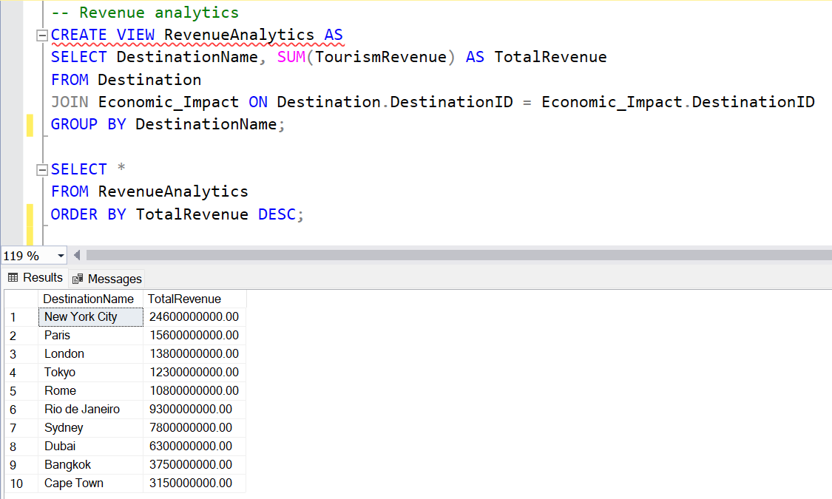
Views
HighSustainabilityDestinations
RevenueAnalytics

Slide 8
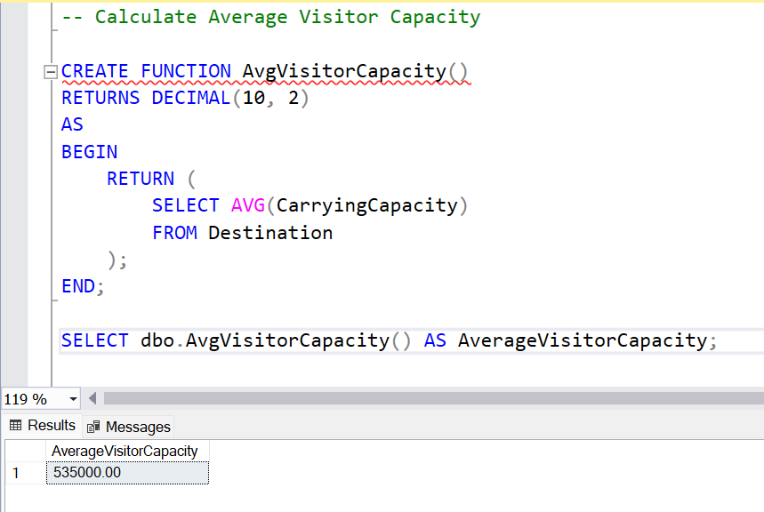
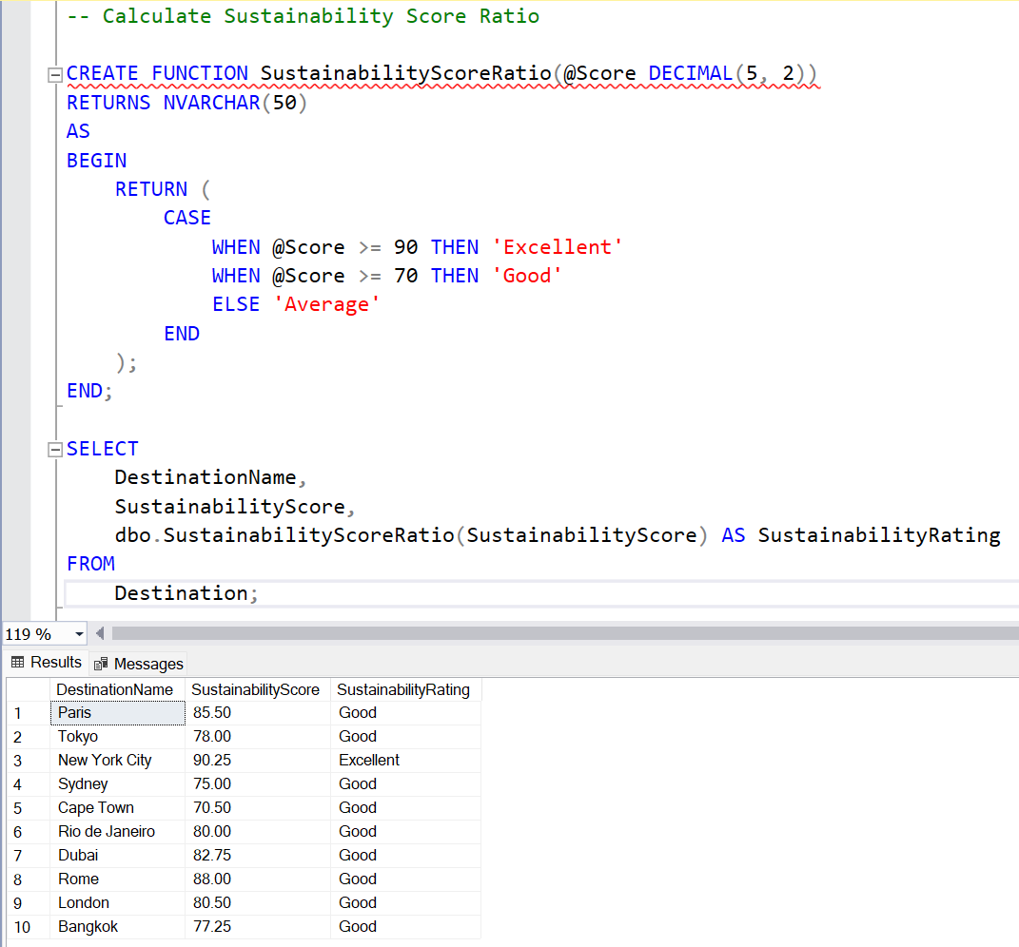
User Defined Functions
AvgVisitorCapacity
SustainabilityScoreRatio

Slide 9
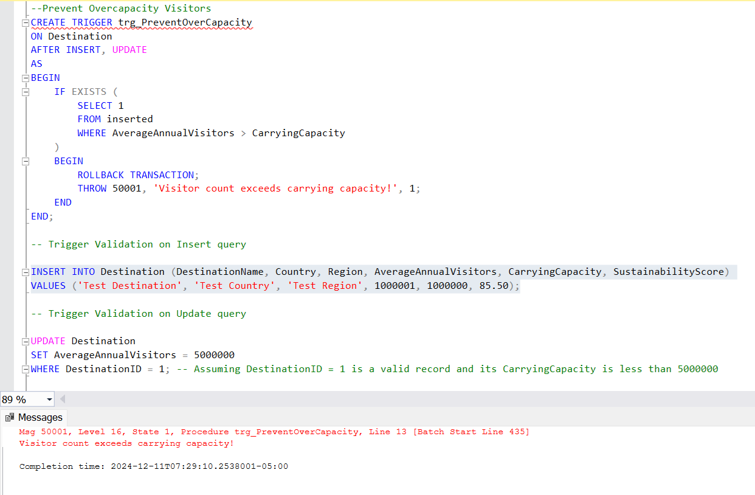
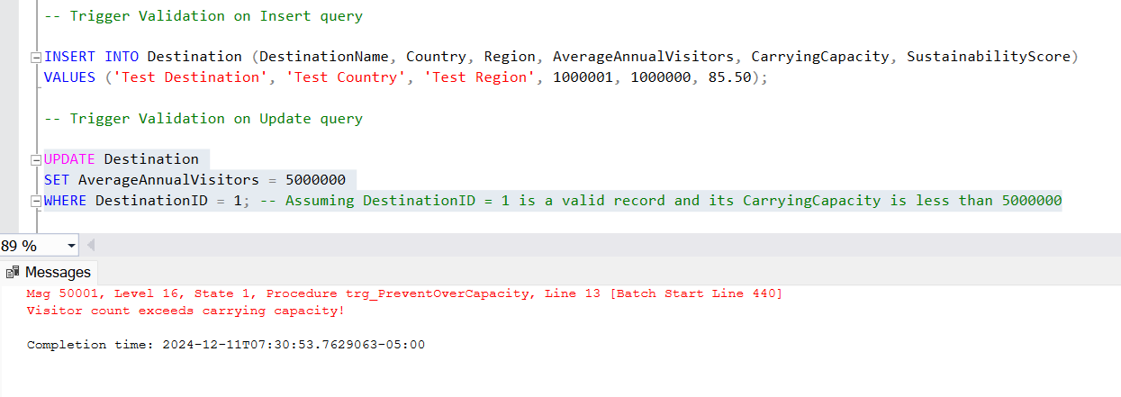
Triggers
Validation for Insert query
Validation for Update query

Slide 10
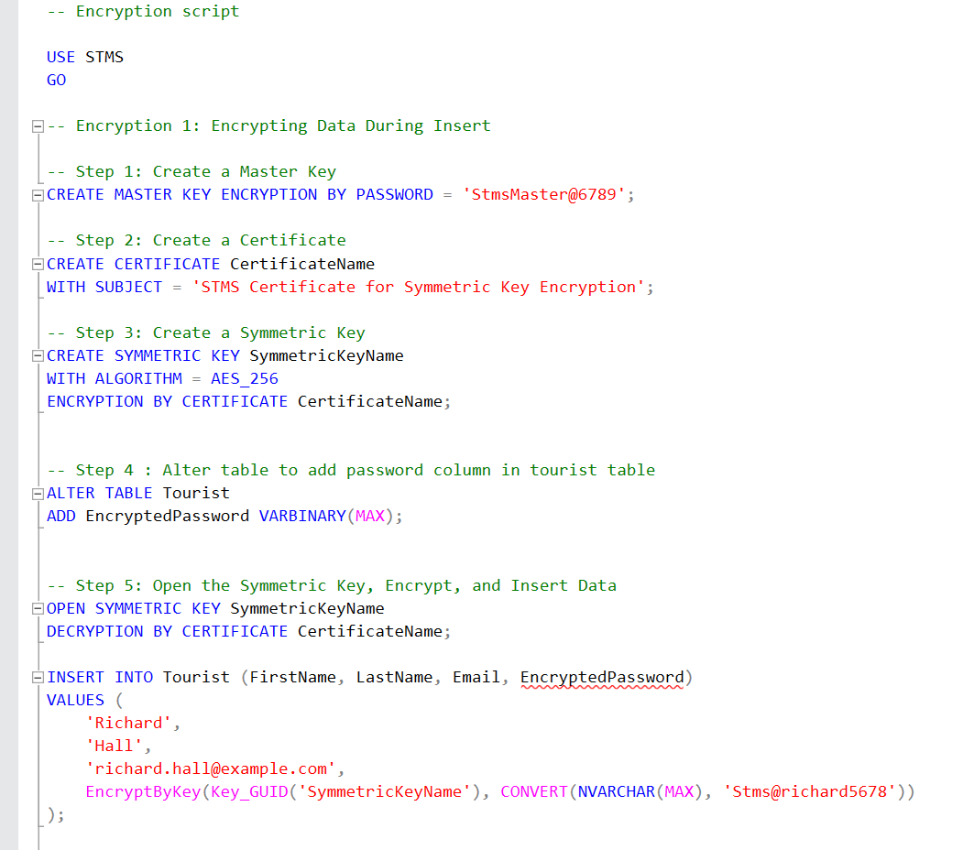
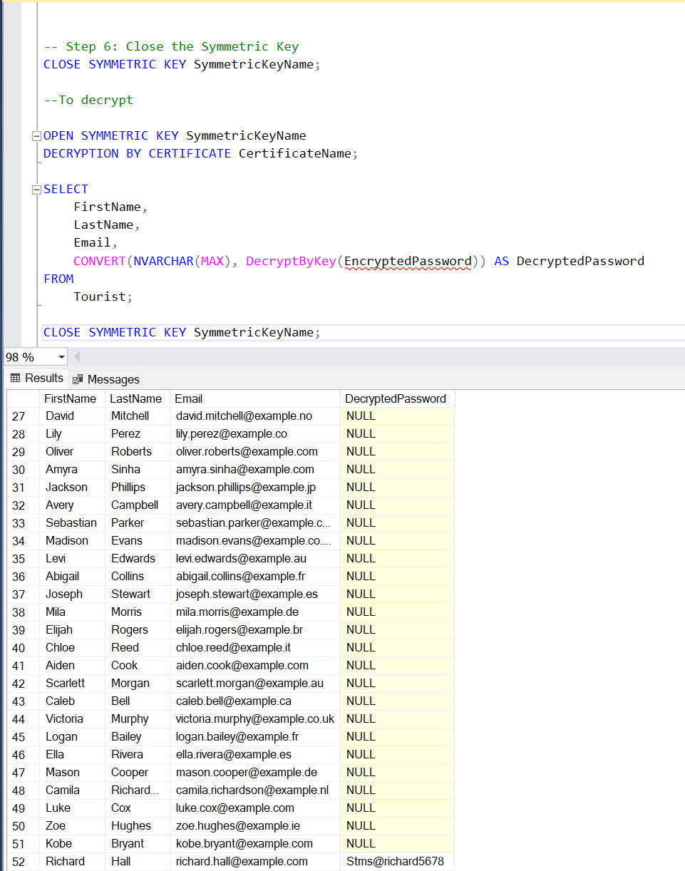
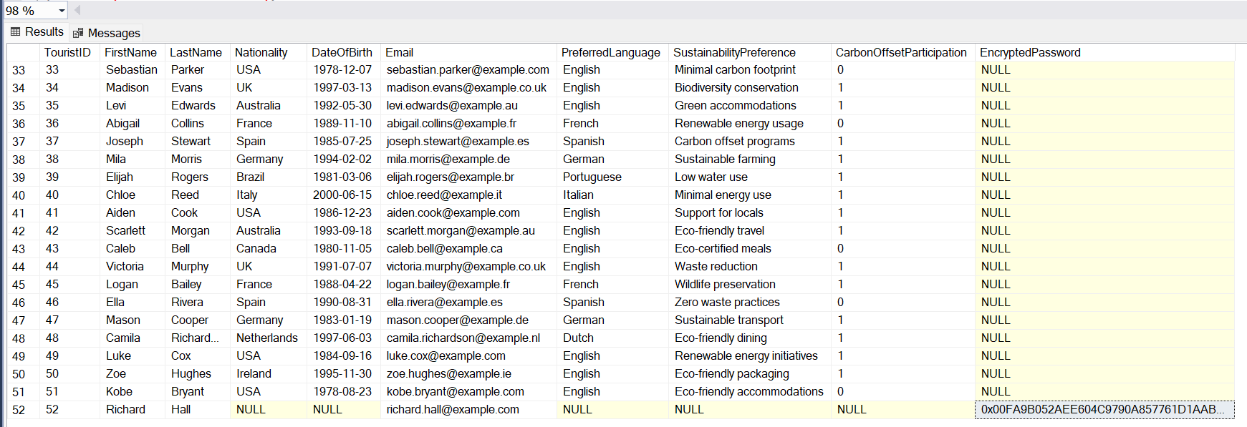
Encryption
To encrypt a password for Tourist.

Slide 11
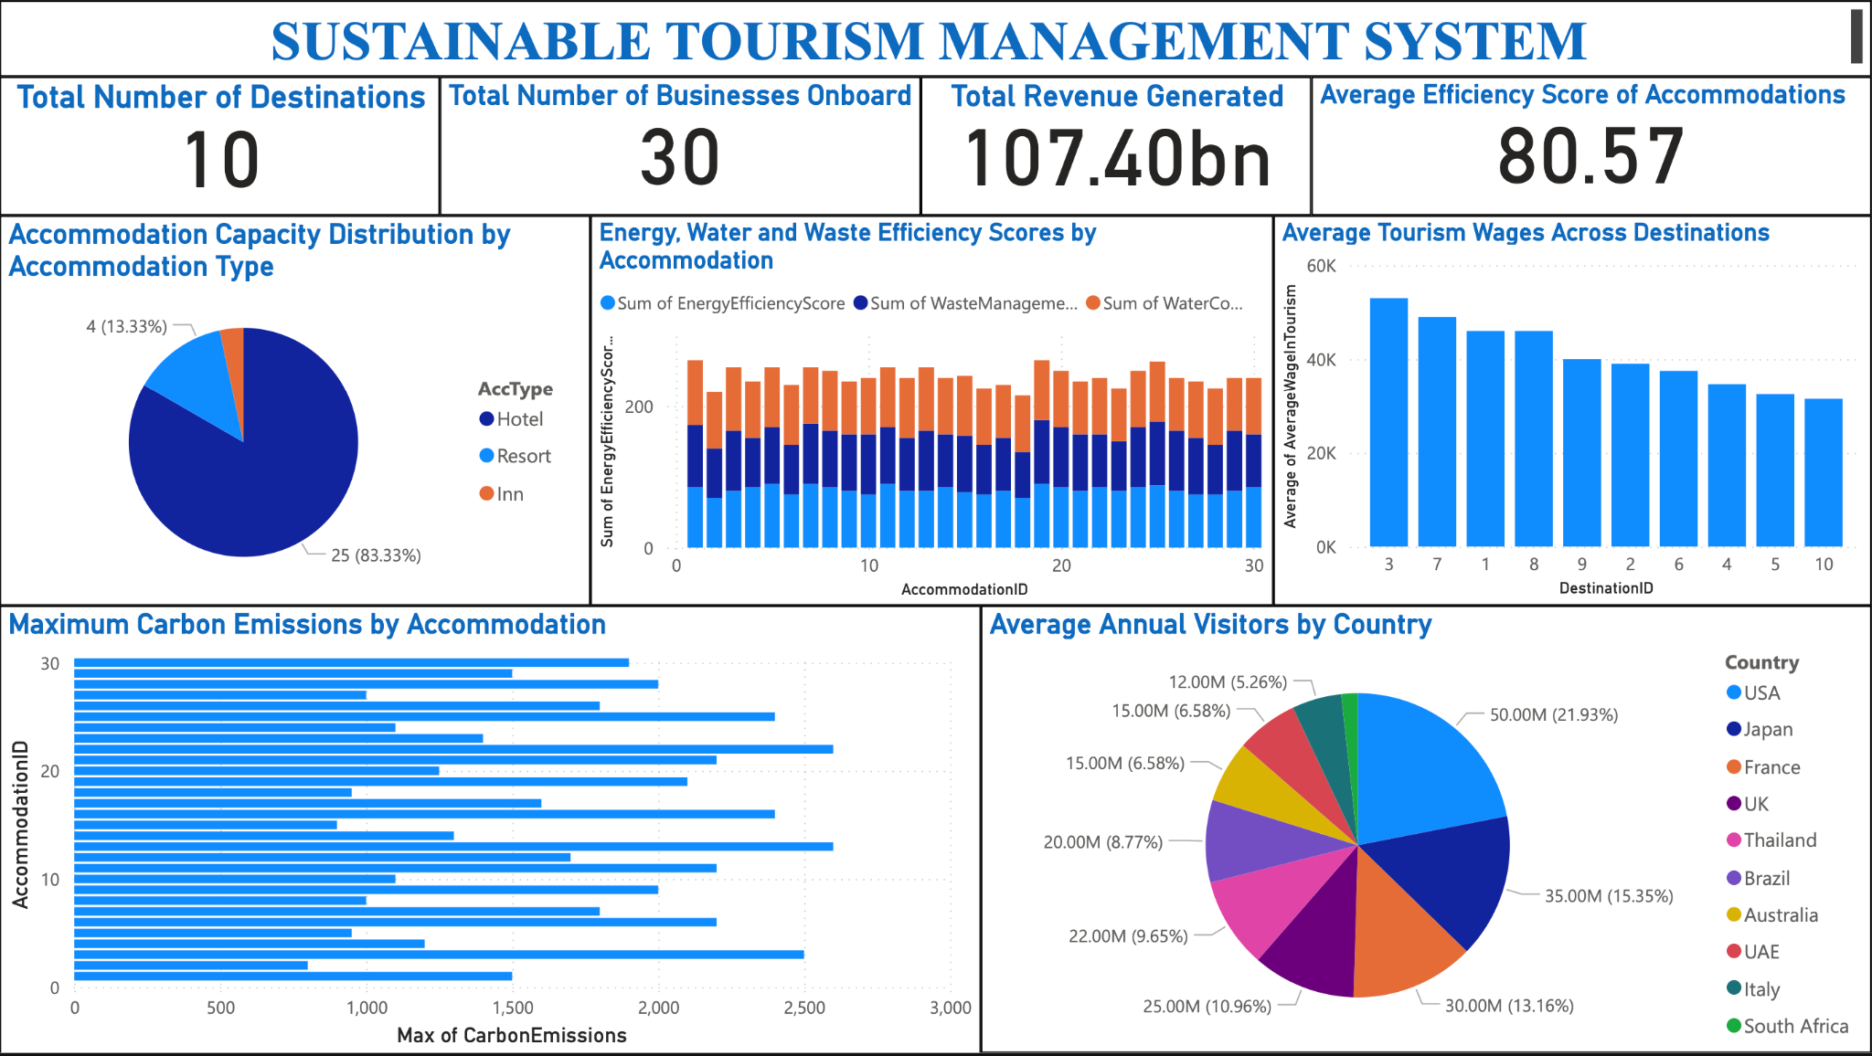
Visualization

Slide 12
THANK YOU !!

